Slide 1
Introduction to
Electronics
Lecture 3 : AC Circuits, Kirchhoff’s Laws & RMS
1

Slide 2
Learning Objectives
Identify open and short circuit conditions and understand protection devices
Apply Kirchhoff’s Voltage Law (KVL) and Current Law (KCL) to complex circuits
Understand AC fundamentals: generation, waveforms, and why AC matters
Describe AC waveform properties: amplitude, frequency, period, and phase
Calculate RMS voltage and current; apply AC Ohm’s Law and power law
Understand measurement of RMS values using different meter types
2

Slide 3
PART 1
Open and Short Circuits
The most common faults in circuits and how to protect against them
3

Slide 4
Open and Short Circuits
The most common circuit faults are open circuits and short circuits
A short circuit causes excessive current flow through all or part of a circuit
This may blow a fuse or burn out a component, resulting in an open-circuit condition
An open circuit is a break in the circuit that prevents current from flowing
Short circuits may be caused by wire crossing, insulation failure, or solder splatter linking two separate conductors
4

Slide 5
Open Circuits and Fuses
An open circuit may result from wire or component lead separation, or from a burned-out component creating a huge resistance
A fuse is used in the circuit and will blow when the current exceeds its rating (given in amps)
Figure 2.59 shows cases of open- and short-circuit conditions
5

Slide 6
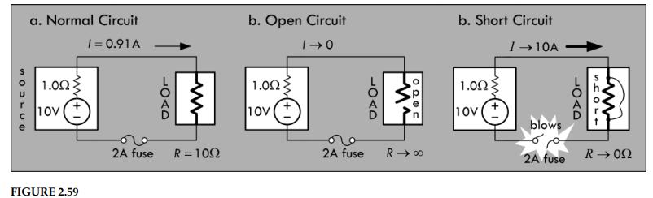
Open and Short Circuit Conditions (Fig. 2.59)
6

Slide 7
Short Circuit Behavior
If all components are ideal, an infinite current flows when an ideal voltage source is short-circuited while the voltage across the short goes to zero
Real voltage sources have internal resistance, so maximum current is reduced . But there is still enough current to cause damage
You can diagnose a short circuit by noting a burning smell or sensing overheating components
Protection devices include fuses, transient voltage suppressors, and circuit breakers can be used to prevent short circuits from destroying circuits
These devices sense excessive current and blow/trip, creating an open-circuit to limit damage
7

Slide 8
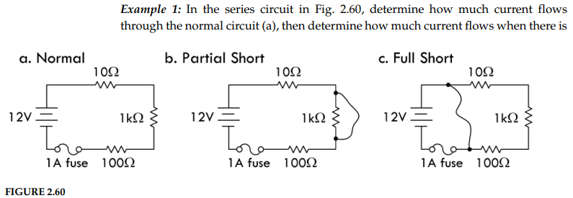
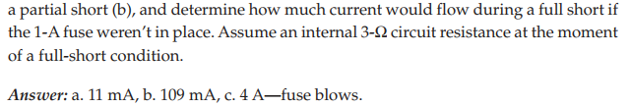
Short Circuit Examples (Fig. 2.60)
8

Slide 9
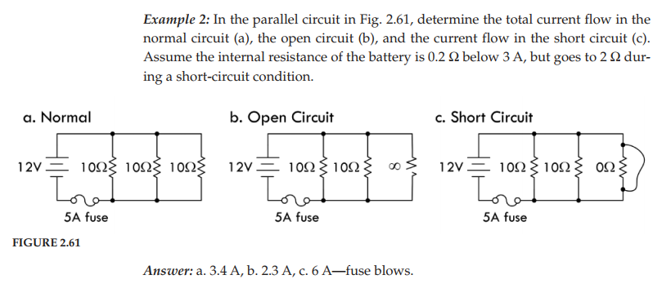
Parallel Circuit — Normal, Open, and Short (Fig. 2.61)
9

Slide 10
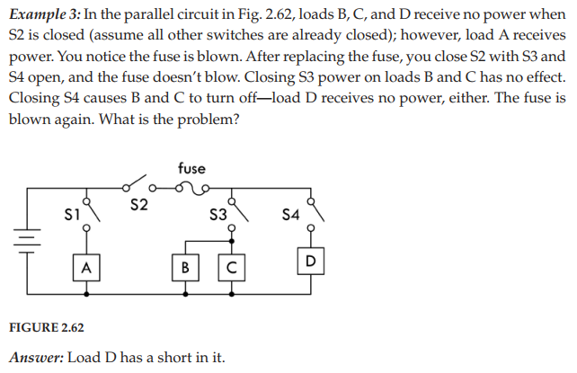
Fuse Behavior in Parallel Circuits (Fig. 2.62)
10

Slide 11
PART 2
Kirchhoff’s Laws for Complex Circuits
The most general method for analyzing any circuit
11

Slide 12
Why Kirchhoff’s Laws?
Often you will encounter circuits that cannot be analyzed with simple resistor reduction alone
Even if you find equivalent resistance, you may not be able to find individual currents and voltages through each component
If there are multiple sources or complex resistor networks, Ohm’s law and divider equations may not be sufficient
Kirchhoff’s laws provide the most general method for analyzing any circuit
They work for linear elements (resistors, capacitors, inductors) and nonlinear elements (diodes, transistors), no matter how complex
12

Slide 13
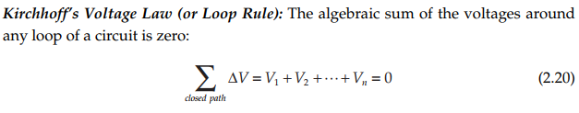
Kirchhoff’s Voltage Law
Kirchhoff’s Voltage Law (KVL):
The algebraic sum of the voltages around any loop of a circuit is zero
KVL is a statement about conservation of energy
13

Slide 14
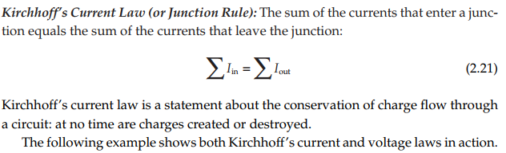
Kirchhoff’s Current Law
Kirchhoff’s Current Law (KCL):
The sum of the currents that enter a junction equals the sum of the currents that leave the junction
KCL is a statement about conservation of charge
14

Slide 15
How KVL Works
If an electric charge starts anywhere in a circuit and goes through any loop back to its starting point, the net change in potential is zero
Start anywhere along the circuit path and choose a direction (clockwise or counterclockwise — it doesn’t matter)
Each time you encounter a circuit element, add its voltage to the loop equation
Use the loop trace rules to determine the sign of each voltage
When you return to the start, set the sum equal to zero
15

Slide 16
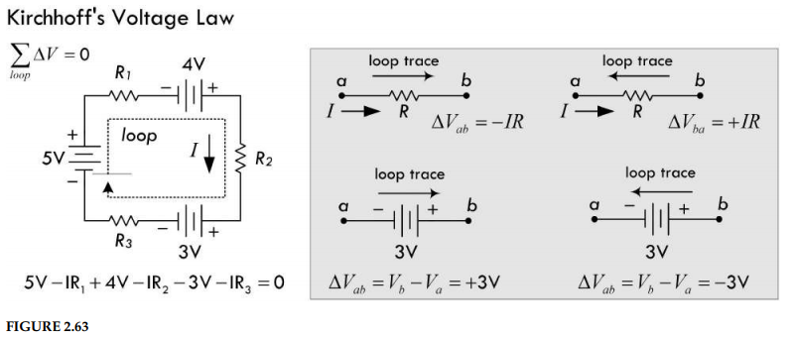
KVL Loop Trace Example (Fig. 2.63)
16

Slide 17
KVL for Any Circuit Elements
Kirchhoff’s voltage law applies to any circuit elements — both linear and nonlinear
It can be applied to circuits with capacitors, inductors, diodes, and sinusoidal sources
The resulting expressions may be complex differential equations, but the law still holds
In practice, there are simpler tricks for solving such circuits, but KVL demonstrates universality
17

Slide 18
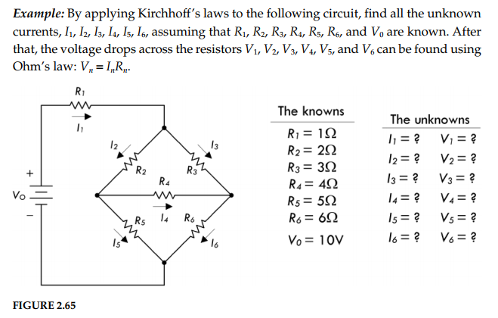
Applying Kirchhoff’s Laws — Example (Fig. 2.65)
18

Slide 19
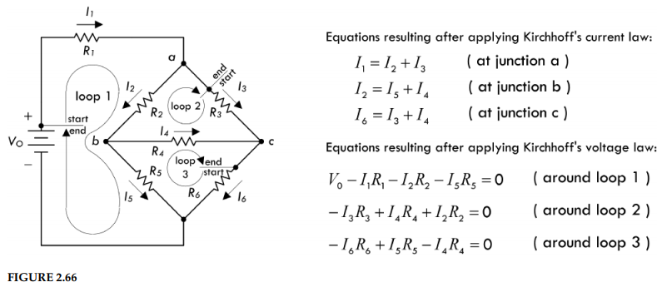
Six Equations, Six Unknowns (Fig. 2.66)
19

Slide 20
Solving Circuits with Kirchhoff’s Laws
Apply KVL to enough closed loops and KCL to enough junctions to get enough equations for the unknowns
After that, it is simply a matter of algebra
As long as you have an equal number of equations and unknowns, you can solve for all values
In Fig. 2.66, there are six equations and six unknowns.
Three methods: (1) Substitution - combine equations and solve one unknown at a time; (2) Matrices; (3) Computational tools
20

Slide 21
PART 3
AC Circuits
Alternating sources, generation, and why AC is essential
21

Slide 22
What Are AC Circuits?
A circuit is a complete conductive path: electrons flow from source to load and back
In DC circuits, electrons flow in only one direction, producing direct current
An alternating source causes current to periodically change direction — this is alternating current (AC)
In an AC circuit, both current and voltage periodically reverse direction
22

Slide 23
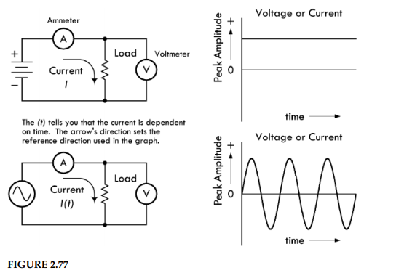
DC Circuit vs. AC Circuit (Fig. 2.77)
The AC circuit is powered by a sinusoidal source generating a repetitive sine wave
Frequency may vary from a few cycles/second to billions, depending on the application
Positive/negative swings simply mean the EMF has switched direction, flipping polarity
23

Slide 24
Understanding AC Voltage Swings
Positive and negative swings relative to a zero-volt reference mean the source EMF has switched directions
The polarity of the voltage source flips, forcing current to change direction
The actual voltage at any instant is measured from the 0 V reference to the point on the sine wave at that time
24

Slide 25
Why Is AC Important?
Easy conversion of circular mechanical motion into induced current via generators
Differentiating or integrating a sinusoid yields another sinusoid. Applying sinusoidal voltage to capacitors and inductors gives a sinusoidal current
Transformers can increase or decrease AC voltage efficiently (at the expense of current)
In DC, transformers are useless. Changing voltage involves resistive power losses
Transformers are very efficient, and little power is lost in the voltage conversion
25

Slide 26
Generating AC
The most common way to generate sinusoidal waveforms is electromagnetic induction via an AC generator (alternator)
A loop of wire rotates mechanically between north and south poles of a magnet
As the loop rotates, the magnetic flux changes, inducing a voltage in the wire
The flux is a function of the loop angle relative to the magnetic field, producing a sinusoidal voltage with angular frequency ω (rad/s)
26

Slide 27
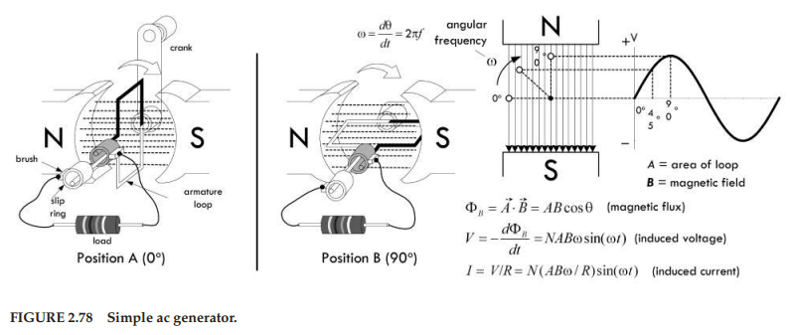
Simple AC Generator (Fig. 2.78)
27

Slide 28
Other Ways to Generate AC
Electromagnetic generators: Convert mechanical energy into electrical energy. Real AC generators are more complex but operate under the same laws of induction
Transducers: Convert physical signal to electrical signal. For example, microphones can also generate AC signals
Electronic oscillators: Convert DC power into periodic AC signals. DC-powered oscillator circuits use inductive and capacitive effects to cause current to resonate back and forth between an inductor and a capacitor
28

Slide 29
Pulsating DC
If current and voltage never change direction, it is still DC even if the level constantly changes
Current that is always positive but varies periodically is called “pulsating DC”
If the current periodically reaches zero, it is “intermittent DC”
Pulsating DC can be viewed as a combination of AC and DC components
Special circuits can separate the two components for separate analysis or use
29

Slide 30
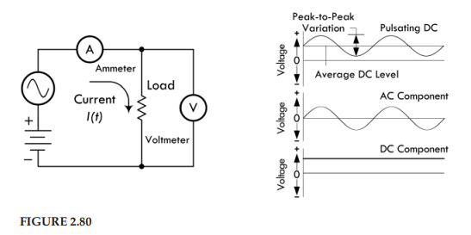
Pulsating and Intermittent DC (Fig. 2.80)
30

Slide 31
Ideal AC Sources
In circuit analysis, we often use ideal sources that maintain a specified waveform regardless of the load connected to them.
An ideal sinusoidal voltage source maintains its voltage regardless of load — supplies as much current as needed
An ideal sinusoidal current source maintains its current regardless of load resistance — supplies as much voltage as needed
You can create ideal sources of other waveforms (square, triangular, etc.)
In the lab, a function generator produces a wide variety of waveforms with varying amplitudes and frequencies
31

Slide 32
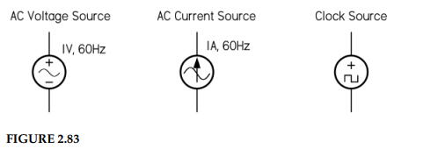
AC Source Symbols (Fig. 2.83)
32

Slide 33
PART 4
AC Waveforms and Properties
Amplitude, frequency, period, phase, and common waveform shapes
33

Slide 34
Describing an AC Waveform
A complete AC description involves three properties: amplitude, frequency, and phase
Figure 2.84 shows a sine wave and its relationship to circular rotation through 360°
Voltage/current varies with the sine of the rotation angle relative to the zero point
sin(90°) = 1 → maximum value; sin(270°) = −1 → maximum reverse value
sin(45°) = 0.707 → the value at 45° is 0.707 × peak value
34

Slide 35
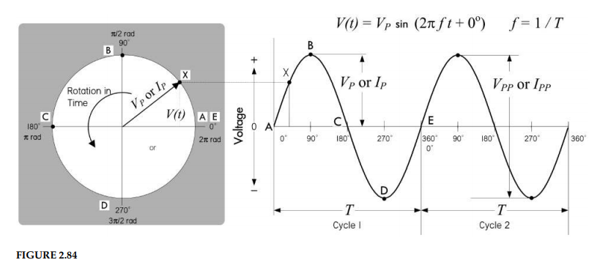
Sinusoidal Waveform and Rotation (Fig. 2.84)
35

Slide 36
AC Waveform Shapes
AC can take many wave shapes besides sinusoidal (Fig. 2.82)
Square waves are vital to digital electronics. The states are either true (on) or false (off)
Triangular and ramp (sawtooth) waves are useful in timing circuits
Using Fourier analysis, any periodic waveform can be created by summing sine waves together
36

Slide 37
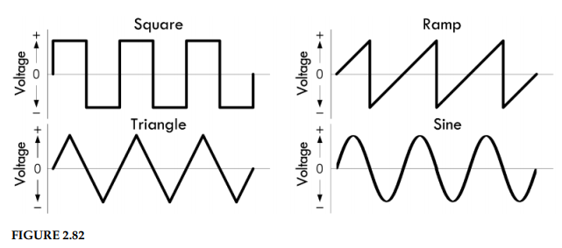
Common AC Waveforms (Fig. 2.82)
37

Slide 38
Frequency and Period
A continuously rotating generator produces AC that passes through many cycles over time
The number of complete cycles per second is the frequency (measured in hertz, Hz)
The period (T) is the time for one complete cycle: T = 1/f
Frequency prefixes: 1 kHz = 1,000 Hz; 1 MHz = 10⁶ Hz; 1 GHz = 10⁹ Hz; 1 THz = 10¹² Hz
Period prefixes: ms (10⁻³ s), μs (10⁻⁶ s), ns (10⁻⁹ s), ps (10⁻¹² s)
38

Slide 39
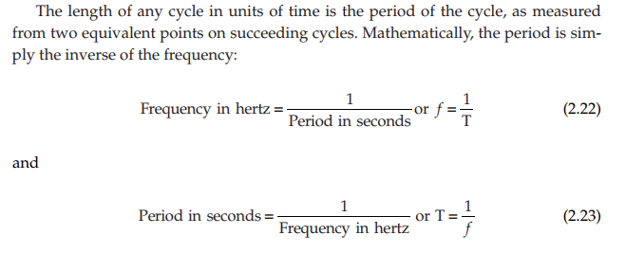
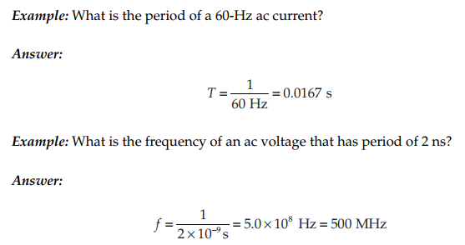
Frequency and Period Relationships
39

Slide 40
Phase
The horizontal axis of an AC graph represents time, but each cycle can be divided into 360°
A conventional starting point is 0° — the zero crossing as voltage begins its positive half cycle
The positive peak occurs at 90° during each cycle
Phase relationships compare two AC waveforms at the same frequency
If waveform B crosses zero after A, B lags A (equivalently, A leads B)
Measuring in degrees makes calculations independent of frequency (Fig. 2.85)
40

Slide 41
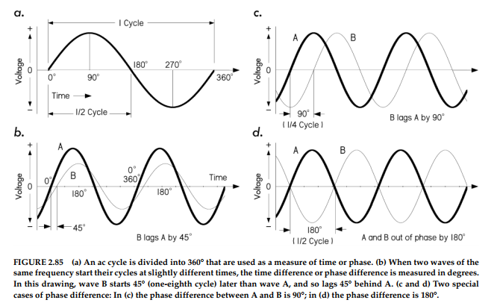
Phase Relationships (Fig. 2.85)
41

Slide 42
Phase — Special Cases
Adding sine waves of the same frequency always produces a sine wave of the same frequency (with unique magnitude and phase)
B lags A by 45° (A leads B by 45°): waveforms add to a composite at an intermediate phase angle
90° phase difference (Fig. 2.85c): one waveform peaks when the other crosses zero (quadrature)
180° out of phase (Fig. 2.85d): one is always positive when the other is negative — if equal, they completely cancel
Phase differences are crucial for understanding AC circuit behavior with capacitors and inductors
42

Slide 43
Combining Sinusoidal Sources
Besides combining AC and DC, we can combine separate AC voltages and currents
Such combinations produce complex waveforms
Two AC waveforms close in frequency produce a beat pattern when combined
Two AC waveforms dissimilar in frequency and amplitude produce irregular composite waveforms
43

Slide 44
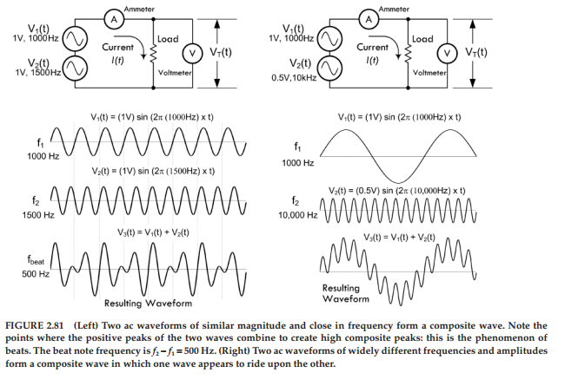
Combined AC Waveforms (Fig. 2.81)
44

Slide 45
PART 5
AC and Resistors, RMS
Effective values and the AC equivalents of Ohm’s Law
45

Slide 46
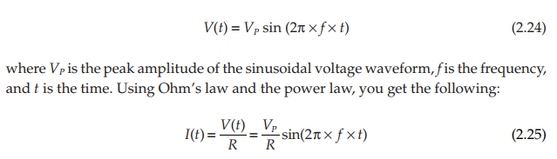
AC Voltage Across a Resistor
Alternating voltage across a resistor produces alternating current in phase with the voltage (Fig. 2.86)
A sinusoidal waveform:
Current and voltage rise and fall together — they are in phase for purely resistive loads
If the load has capacitance or inductance, current and voltage will NOT be in phase
46

Slide 47
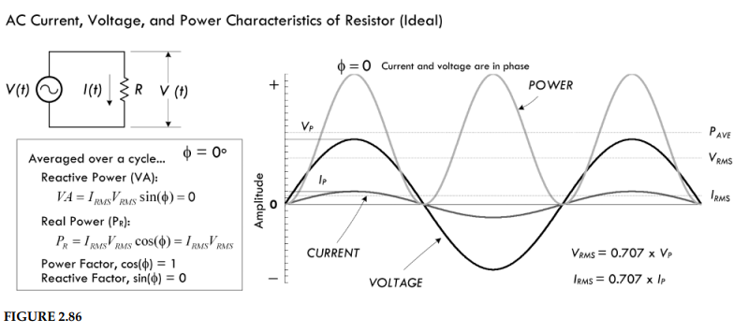
AC Voltage and Current in a Resistor (Fig. 2.86)
47

Slide 48

Instantaneous Power
Plugging the sinusoidal voltage into the power law:
This gives instantaneous power at any specific time t
But how often do you need the power at exactly t = 1.3 s? When do you start counting?
Instantaneous values are typically inconvenient for practical use
We need an averaging scheme to calculate effective power dissipation
48

Slide 49
Why Not Just Average?
You might try averaging the sinusoidal voltage over a complete cycle
But the average of a sine wave over one cycle is zero — positive and negative halves cancel!
This is confusing for power, since both halves deliver energy
We need a better measure: the RMS (Root Mean Square) value
49

Slide 50
RMS — Root Mean Square
Square the instantaneous values → take the mean (average) → take the square root
RMS values don’t average to zero and are the AC equivalent of DC voltages/currents
RMS is based on equating AC and DC power needed to heat a resistive element to the same degree
Peak AC power is twice the equivalent DC power, so average AC power = ½ peak AC power
50

Slide 51
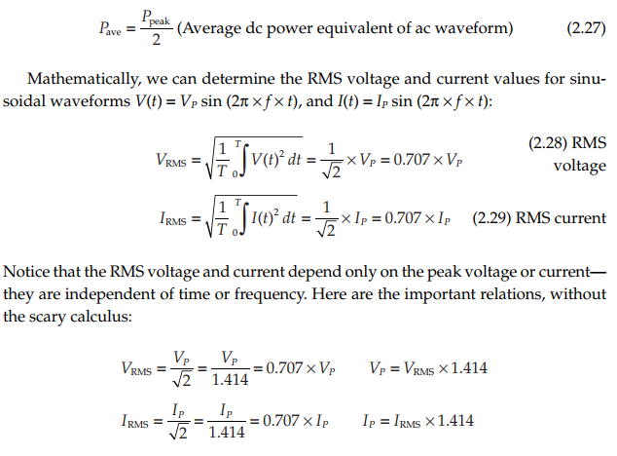
RMS Derivation and Formulas
51

Slide 52


RMS in Practice — Household AC
U.S. utilities provide 60 Hz, 120 V AC (Europe: 50 Hz, 240 V AC)
The “VAC” unit means the supplied voltage is given in RMS
On an oscilloscope: V(t) = 170 V sin(2π × 60 Hz × t), where 170 V is the peak
AC Ohm’s Law:
AC Power Law:
52

Slide 53
Important Notes on AC Laws
These AC Ohm’s law and power law equations apply only to purely resistive circuits
Circuits with capacitance and/or inductance require more complex power calculations
Being able to convert between RMS, peak, peak-to-peak, and half-wave average values is essential
This is especially important for component voltage and current ratings
Most of the time, AC voltage is expressed as RMS unless otherwise stated
53

Slide 54
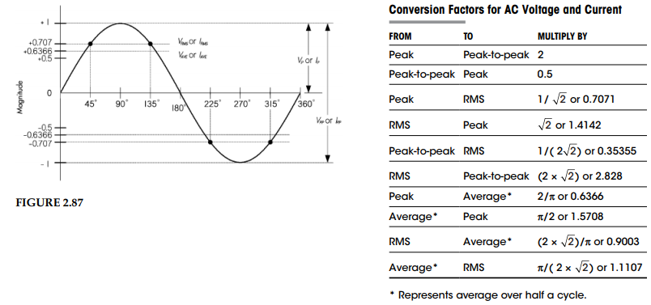
RMS, Peak, and Peak-to-Peak Relationships (Fig. 2.87)
54

Slide 55
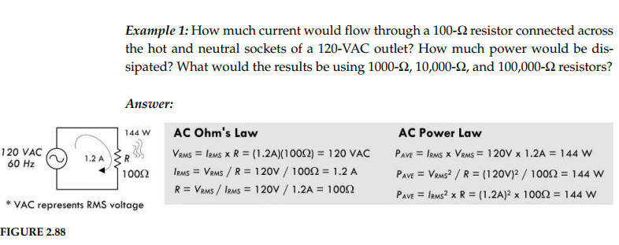
Worked Examples — Calculations (Fig. 2.88)
55

Slide 56
Worked Examples — AC Power
A 100 Ω resistor connected across a 120 VAC outlet dissipates P = V²/R = 120²/100 = 144 W
Don’t try this with an ordinary resistor — you’d need a power resistor rated above 144 W!
A 1,000 Ω resistor: P = 14.4 W; a 10,000 Ω resistor: P = 1.44 W; a 100,000 Ω resistor: P = 0.14 W
Peak voltage on oscilloscope: V_peak = V_RMS × √2 = 120 × 1.414 = 170 V
56

Slide 57
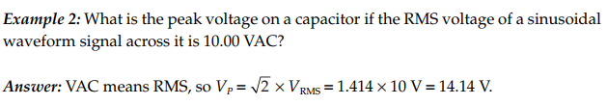
More Worked Examples – Example 2
57

Slide 58

More Worked Examples – Example 3
58

Slide 59
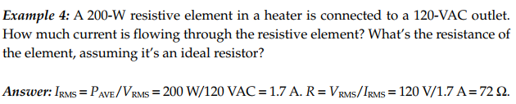
More Worked Examples – Example 4
59

Slide 60
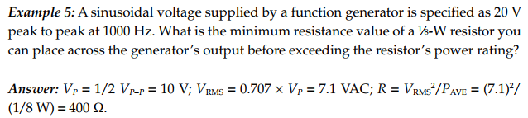

More Worked Examples (continued)
60

Slide 61
PART 6
Measuring RMS Voltages
and Currents
Understanding how meters work and their limitations
61

Slide 62
Measuring RMS Voltages and Currents
Many digital multimeters do NOT measure RMS directly
They often measure the peak value and calculate the equivalent RMS assuming a sinusoidal waveform
Analog meters usually measure the half-wave average but indicate the equivalent RMS
True RMS multimeters measure the actual RMS value — especially useful for non-sinusoidal signals
True RMS meters also include the contribution of any DC components present with the AC
62

Slide 63
Using Conversion Tables
You can estimate RMS values from other measurements (peak, peak-to-peak, half-wave average) using conversion factors
For a sine wave: V_RMS = 0.707 × V_peak = 0.354 × V_pk-pk
For square waves and triangular waves, the conversion factors are different
You must know how your meter makes its measurement — peak-based or average-based — to use tables correctly
Take care when measuring non-sinusoidal waveforms with non-true-RMS meters
63

Slide 64
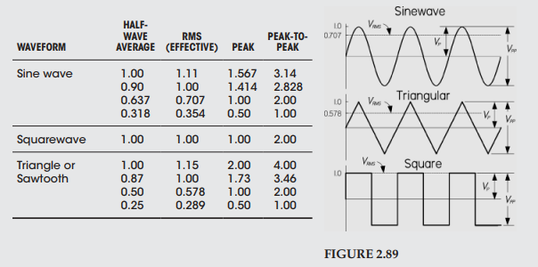
Conversion Factors for AC Values (Fig. 2.89)
64

Slide 65
End of Lecture
Questions?
65

